Slide 1

Institute of European Certification of Personnel

Slide 2




Our Activities
Certification of Competences
Certiport © Service Provider
European Projects

Slide 3


Certification of Competences
Our mission is to certify the verifiable formal and non-formal competences of professionals and individuals, through a set of standardised requirements, procedures and quality assurance measures, in accordance to International Standards.

Slide 4

Certiport ©
Service Provider
Certiport is dedicated to helping people succeed through certification. Certiport globally recognized credentials are aimed at enhancing individual productivity, marketability, and value. We deal with the territorial distribution of exam licenses and the start-up of testing centers (CATC: Certiport Authorized Testing Center).

Slide 5

Certification Process
Identification of the specific competences to be certified, identified in national and international official taxonomies: ISO, ESCO, ISCO, EQF
Preparation of a specific Certification Protocol and Scheme
Submission of application documents
Online examination on our dedicated platform competenceinstitute.com
Issue of digital certificate
Monitoring the continued fulfilment of requirements
Certification Process

Slide 6

European Projects
Icep specialises in international and Eu-funded projects, focusing on Education & Training and in Socio-economic inclusion of vulnerable people.
Department members are experienced in managing all stages of a project, from elaborating a proposal, to leading or co-leading a partnership in implementing activities and monitoring finances, performing evaluation of results and disseminating outcomes.

Slide 7

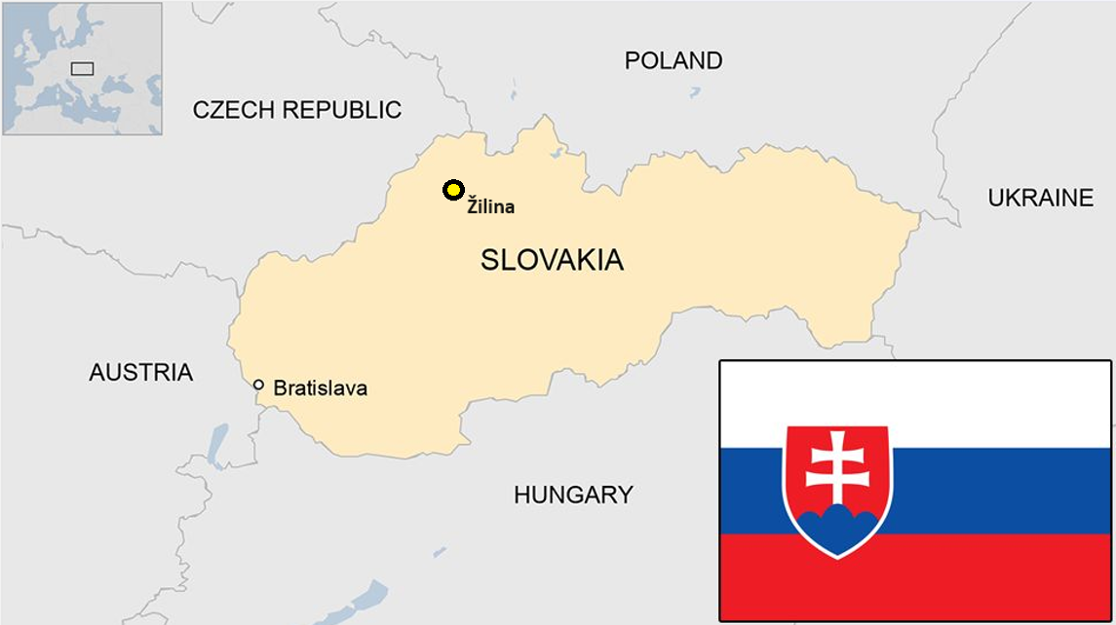
Our locations

Slide 8





Our team
Cataldo Riggi
CEO
Lucia Figuli
Project Manager
Adelaida Fanfarová
Project Manager & Researcher
Ladislav Mariš
IT technician

Slide 9



Slide 10




iceponline.com
info@iceponline.com
iceponline

